Slide 1
Improper Payments Initiative
Why this is a key priority for VA?
Reducing improper payments is VA’s #1 financial management priority
The President and the Office of Management and Budget (OMB) have made eliminating waste, fraud, and abuse in Federal programs, including reducing and recapturing erroneous payments, one of its top financial goals.
The March 2012 VA OIG report found VA non-compliant with the Improper Payments Elimination and Recovery Act (IPERA) of 2010.
VA expects VA OIG to find VA non-compliant for a second consecutive year in March 2013; anticipated findings include:
Sampling and estimation methodologies do not comply with OMB requirements.
Targets for reducing improper payments were not achieved.
2012 PAR showed a slight reduction in reported improper payments -$2.2 billion for 2011 versus $2.4 billion in 2010.
Goals to be accomplished
Reduce the number and value of improper payments made by VA.
Improve improper payment identification and reporting processes.
Comply with the provisions of IPERA.

Slide 2
Commercial Small Business Payments
Note: OMB instructed Agencies to accelerate payments to small businesses with the goal of paying small businesses within 15 days of receipt of appropriate documentation. Delivery of goods and acceptance of services must still occur before making payment. VA has for many years used existing authority in the Prompt Payment Act to accelerate commercial vendor small business payments after receiving all proper documentation, including acceptance. Entities designated as small businesses are submitted for payment through FMS (not money managed) when acceptance occurs.
January Highlights:
VA paid 93 percent of small business invoices in January (FYTD 94 percent) within the 15 day timeliness metric bettering the VA goal
Station 791 (Denver Acquisition and Logistics Center) continues a new high volume small business contract for the repair of hearing aids paid within the 15 day timeliness metric which has helped boost payment timeliness
FSC has issued a notice to VA stations highlighting the OMB goal and encouraged timely certification of invoices and receipt processing during VHA Fiscal Officers Calls
FSC has used mail campaigns to vendors to promote ways to shorten the payment cycle time and obtain payment information by using Electronic Funds Transfer (EFT), Electronic Invoicing, Central Contractor Registration (CCR), and FSC’s Vendor Inquiry System (VIS) web portal to monitor payment information
FSC continues to analyze small business payment data to identify opportunities to further increase payment timeliness and will work with Administrations/Stations to identify causes for delayed payments and potential procedures for accelerating payments
Prepared by: Kevin Miers, Systems & Procedures Analyst, VA Financial Services Center, Kevin.Miers@va.gov
Approved by: Robert Adams, Deputy Director, VA Financial Services Center, (512) 460-5002
Version Date: February 7, 2013

Slide 3
Metric:
Linkages
Org | OM (Finance)
B/Line | Enabling
B/Scorecard | Operations
Strategic Goal | 4
Corp Outcome | Improve Management and Support Services Timeliness and Quality
Status
Current Month (Jan)
Next Month (Feb)
Projected Green Date | N/A
Monthly Actual | 93%
FYTD Actual | 94%
Commercial Small Business Payment Timeliness
G
G
Metric ID | OM (Finance)-197
Timeliness Exceeds Goal
↑
Desired
Direction
Percent Paid Within 15 Days of Receipt of Proper Payment Documentation
↓
Desired
Direction
Trend
Variance Thresholds
Red | ≤ -10%
Yellow | ≤ -5%
Green | > -5%
Notes:
Metric Format - Percentage

Slide 4
Overall Commercial Vendor Payment Timeliness
Note: Overall Commercial Vendor Payment Timeliness measures VA vendor payment timeliness against the July 2012 OMB guidance to pay all commercial vendors within 15 days of receipt of all payment documentation. Delivery of goods and acceptance of services must still occur before making payment.
January Highlights:
In August 2012, VA established a new Prompt Payment Type Code (“Y”) to facilitate acceleration of commercial vendor payments to pay at 14 days after receipt of all proper payment documentation
FSC worked with the Denver Acquisition and Logistics Center (DALC) to program the use of the new Prompt Payment Type “Y” code to pay their EDI prosthetics payments
During January, VA paid 85 percent (FYTD 84 percent) of all commercial vendors within the 15 day OMB goal
FSC paid 87 percent of January’s payments within the 15 day OMB goal
Non-FSC entities paid 83 percent of all commercial vendors within the 15 day OMB goal
Prepared by: Kevin Miers, Systems & Procedures Analyst, VA Financial Services Center, Kevin.Miers@va.gov
Approved by: Robert Adams, Deputy Director, VA Financial Services Center, (512) 460-5002
Version Date: February 7, 2013

Slide 5
Metric:
Linkages
Org | OM (Finance)
B/Line | Enabling
B/Scorecard | Operations
Strategic Goal | 4
Corp Outcome | Improve Management and Support Services Timeliness and Quality
Status
Current Month (Jan)
Next Month (Feb)
Projected Green Date | N/A
Monthly Actual | 85%
FYTD Actual | 84%
G
G
Overall Commercial Vendor Payment Timeliness
G
Metric ID | OM (Finance)-198
Timeliness Above Goal
↑
Desired
Direction
Percent Paid Within 15 Days of Receipt of Proper Payment Documentation
↓
Desired
Direction
Trend
Variance Thresholds
Red | ≤ -10%
Yellow | ≤ -5%
Green | > -5%
Notes:
Metric Format - Percentage

Slide 6
Undelivered Orders (UDOs)
Note: OMB Circular A-123, Management Responsibility for Internal Controls, requires that management be responsible for establishing and maintaining internal controls to achieve the objectives of effective and efficient operations, reliable financial reporting, and compliance with applicable laws and regulations. To ensure compliance with the above circular and Generally Accepted Accounting Principles (GAAP), VA Financial Policies and Procedures Manual, Volume II, Chapter 5, Section 050204 requires monthly reviews and reconciliations be performed to ensure that open obligations, including undelivered orders (UDOs) and delivered unpaid obligations, are valid and appropriate and adjustments are made as necessary.
January Highlights:
OFPIAR analyzed VA-wide open obligations, established a baseline, and identified all UDOs that need to be reviewed for appropriate financial or administrative actions. The baseline, established September 30, 2012, totaled $1,086,569,995.
The Office of Management’s memorandum dated December 17, 2012 required Administration CFOs and Staff Offices to review open obligations comprised of contracts, travel, and other obligations, to determine obligations which should be closed or where the period of performance needed to be modified. A detailed list of each organization’s aged UDOs was provided.
OFPIAR is tracking and monitoring Administrations’ and Staff Offices’ progress monthly. As of January 31, 2013, the UDO balance has been reduced to $574,254,345, a 47% reduction from the baseline. Therefore, the percentage of UDOs remaining is 53%, bringing VA close to its FY 2013 year-end target of 40%.
Prepared by: Pushparajan Arokiaswamy, Office of Financial Process Improvement and Audit Readiness. Pushparjanan.Arokiaswamy@va.gov.
Approved by: Shirley Pratt, Associate Deputy Assistant Secretary, Office of Financial Process Improvement and Audit Readiness. Shirley.Pratt@va.gov
Version Date February 5, 2013

Slide 7
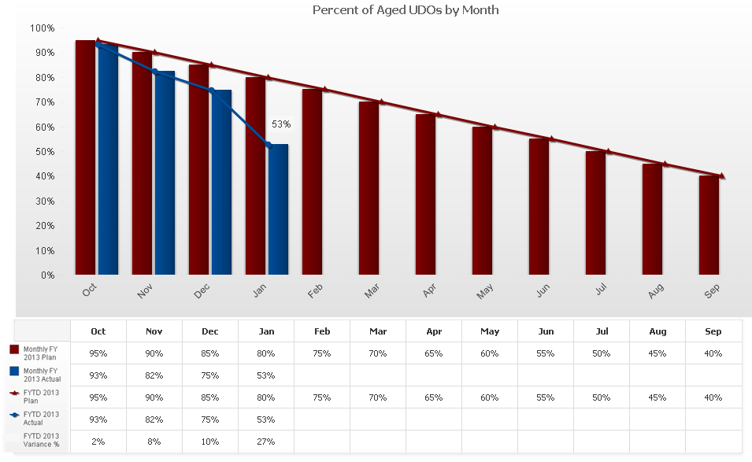

Metric:
Linkages
Org | OM (Finance)
B/Line | Enabling
B/Scorecard | Operations
Strategic Goal | 4
Corp Outcome | Improve Timeliness in Closeout of Aged Undelivered Orders
Status
Current Month (Jan)
Next Month (Feb)
Projected Green Date | N/A
Monthly Actual | 53%
FYTD Actual | 53%
NEW: Closeout of Aged Undelivered Orders
G
G
Metric ID | OM (Finance)-197
Closed Undelivered Orders Exceeds Target
↓
Desired
Direction
Desired
Direction
Variance Thresholds
Red | <-10%
Yellow | <-5%
Green | ≥-5%
Notes:
Metric Format - Percentage

Slide 8
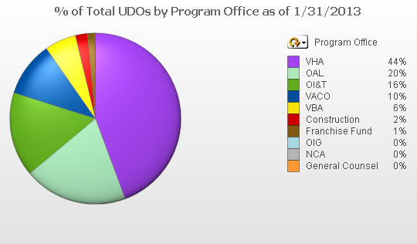
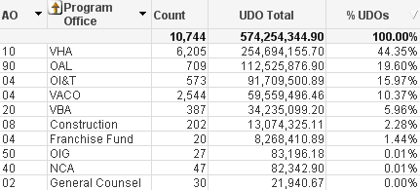
Status of Aged Undelivered Orders
Balance by Program Office as of January 31, 2013

Slide 9
Status of Aged Undelivered Orders
Balance by Program Office as of January 31, 2013
FYTD Reduction by Program Office
Monthly Balance Detail by Program Office

Slide 10
Linkages
Org | OM
B/Line | Enabling
Metric Type | Performance
B/Scorecard | Operations
Initiative | N/A
Strategic Goal | 4
Corp Outcome | Improve Management and Support Services Timeliness and Quality
Metrics Detail: Commercial Interest Penalties Summary FY 2013 IPM Performance Over FY 2013 goal
*The monthly, FYTD, and annual goal for this measure is the same.
**No annual goal for total dollar value interest penalties.
Data Through January 2013
Notes:
10
10

Slide 11
Note: The FY 2013 interest per million dollars disbursed goal of $13 for commercial payments subject to Prompt Pay Act (PPA) reflects a 5 percent improvement over the FY 2012 actual performance level.
January Highlights:
VA Commercial Interest Per Million (IPM) increased from $13 in December to $27 for January, above the VA goal. Despite the increase, the FYTD 2013 IPM performance level of $15 is 13 percent better than the FYTD 2012 performance level ($17) for the same period.
The spike in commercial IPM was driven by the normal “holiday effect” experienced November – February annually and three property management payments to a vendor processed by VBA’s Administrative and Loan Accounting Center (ALAC). The ALAC interest penalties totaled $6.8K or 20 percent of January’s commercial interest total; ALAC indicates they held the payments pending a contracting update causing the interest.
The IPM on FSC processed commercial payments increased from $13 in December to $16 in January also consistent with the normal “holiday effect”. However, FSC’s FYTD 2013 IPM level of $11 remains 25 percent better than the FYTD 2012 performance level ($15).
Supplemental Information:
VA’s overall IPM level increased from $26 in December to $43 for January. However, VA’s FYTD FY 2013 IPM level ($28) is 41 percent lower than the FYTD 2012 performance level ($48).
IPM on Fee Basis payments increased from $161 in December to $194 in January. However, the FYTD 2013 IPM level ($165) is 58 percent lower than the FYTD 2012 performance level ($390).
Six stations paid more than $1.0K in Fee Basis interest penalties ($13.0K or 48 percent of Fee Basis interest for January). The stations were: Harlingen, TX, Los Angeles, CA, Cleveland, OH, Cincinnati, OH, Salem, VA, and Portland, OR.
Last 12 Months:
Commercial Interest $181K
Commercial PPA Principal Amount $14.5B
Prepared by: Kevin Miers, Systems & Procedures Analyst, VA Financial Services Center, Kevin.Miers@va.gov
Approved by: Robert Adams, Deputy Director, VA Financial Services Center, (512) 460-5002
Version Date: February 7, 2013

Slide 12
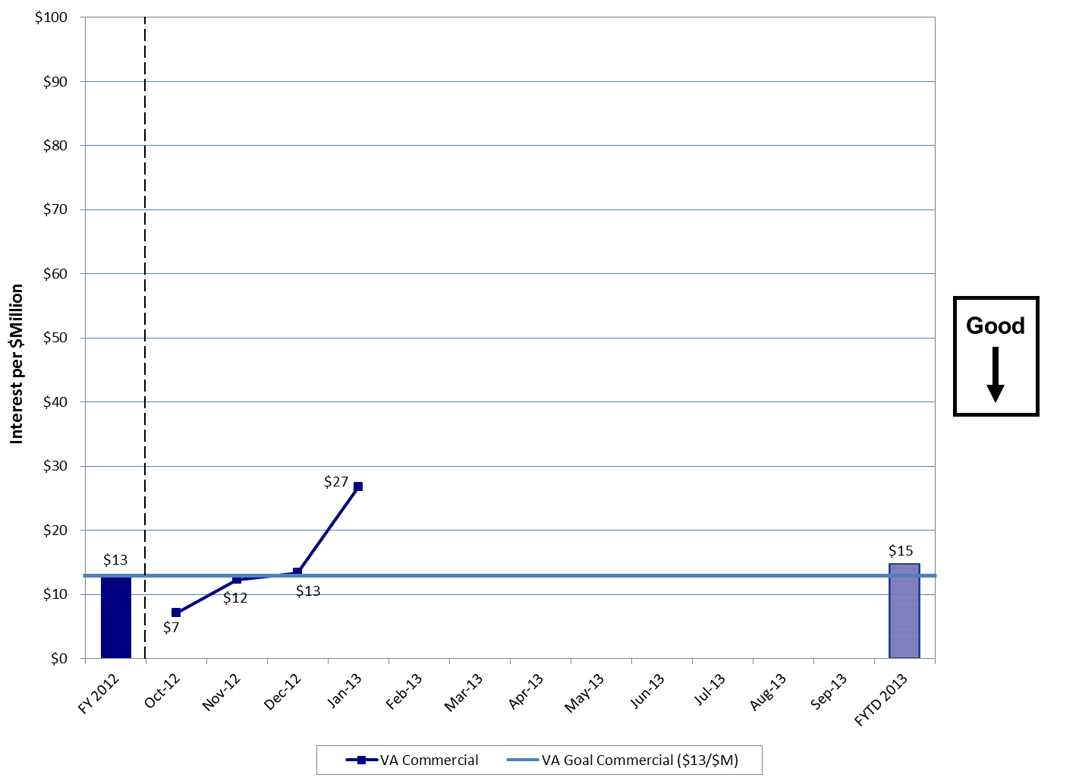
FY 2013 Interest per $Million Commercial Payments
Bottom Line:
VA Commercial Payments Interest Per Million (IPM) increased from $13 in December to $27 for January. However, the FYTD 2013 IPM performance level ($15) is 13 percent better than the FY 2012 FYTD performance level ($17).
Notes:
12
12

